Slide 1
Massachusetts Bay Transportation Management System - Commuter Rail
EkTA SINGH
DBMS-FALL 2016

Slide 2
Project purpose
Massachusetts bay transportation authority wants to develop a database to keep a track of their employees, customers, train schedules, train lines and their stations.
This database will help increase the efficiency of the authority to serve their customers well.
It will also help to answer certain frequently asked questions with the help of its stored procedures.
Customers as well as employees can use the database to find answers to general questions and certain analytical questions.

Slide 3
ER DIAGRAMS
Without NORMALIZATION

Slide 4
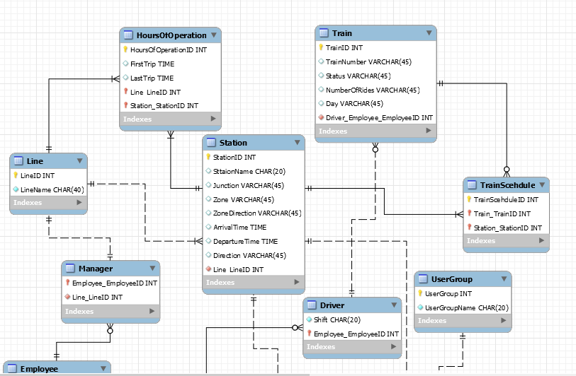
ER diagram without normalization - Part 1

Slide 5
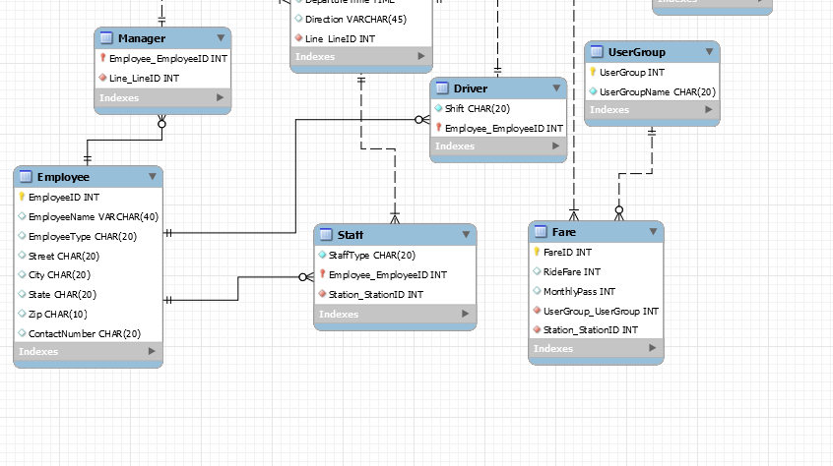
ER diagram without normalization - Part 2

Slide 6
ER DIAGRAMS
With NORMALIZATION

Slide 7
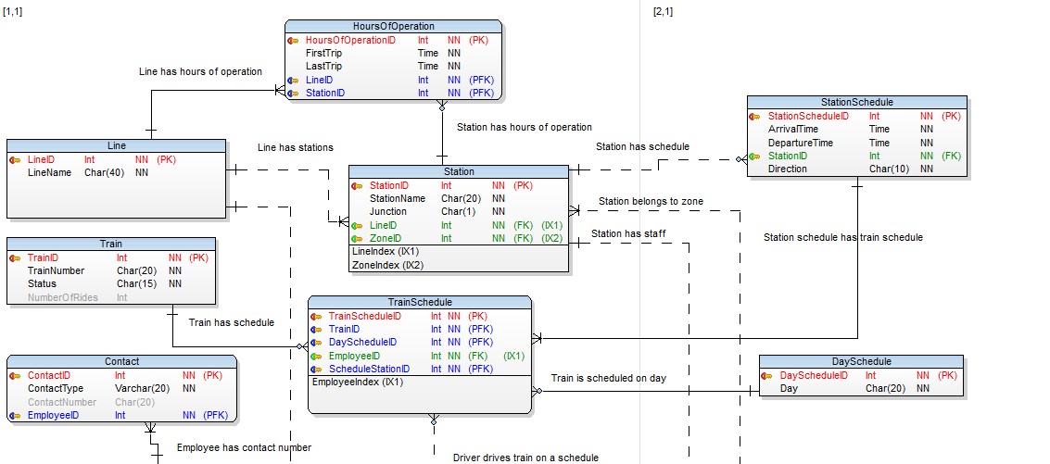
ER diagram with normalization - Part 1

Slide 8
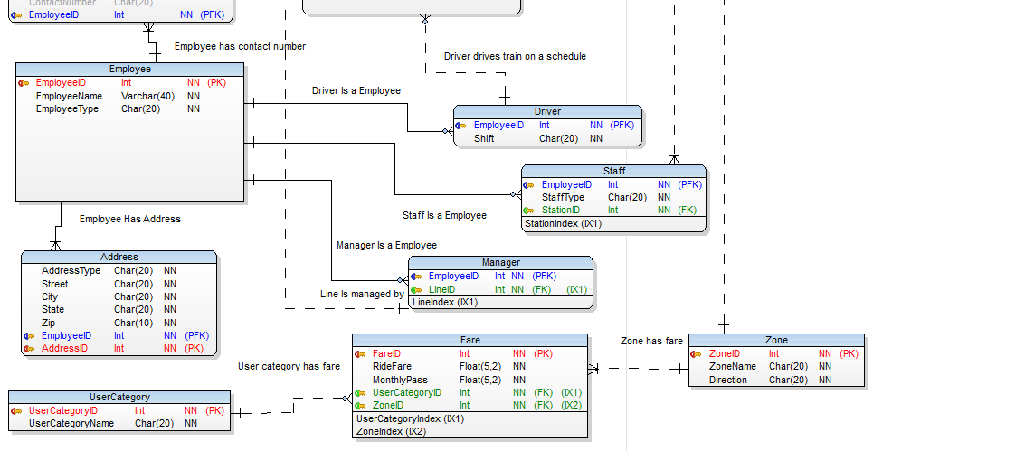
ER diagram with normalization - Part 2

Slide 9
VIEWS

Slide 10
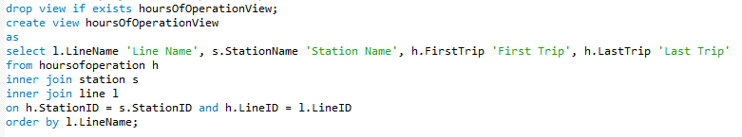
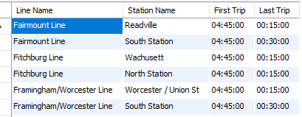
View to display hours of operation per line with first and last station

Slide 11
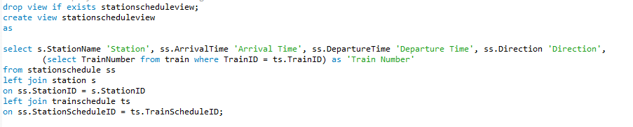
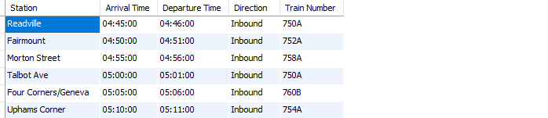
View to display station schedule

Slide 12
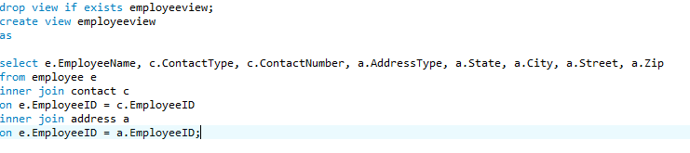
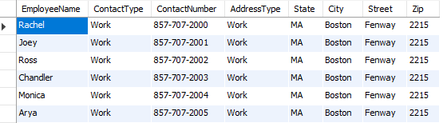
View to display employee name, contact and address

Slide 13
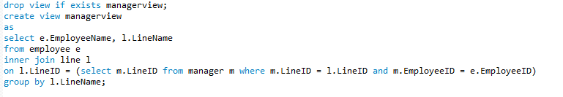
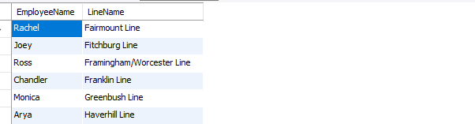
View to display line name and its manager

Slide 14
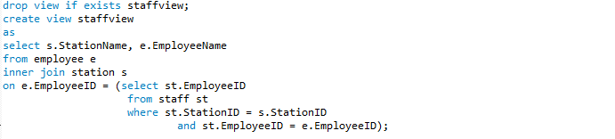
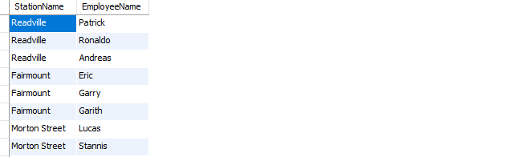
View to display station name and their staff

Slide 15
TRIGGER

Slide 16
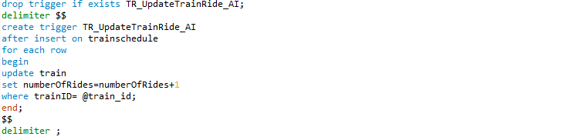
Trigger to update number of rides of train every time it is scheduled

Slide 17
FUNCTION

Slide 18
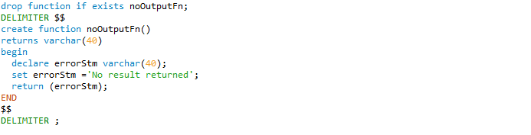
Function to show no record found by stored procedure

Slide 19
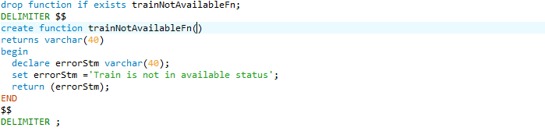
Function to show train is not available

Slide 20
STORED PROCEDURE

Slide 21
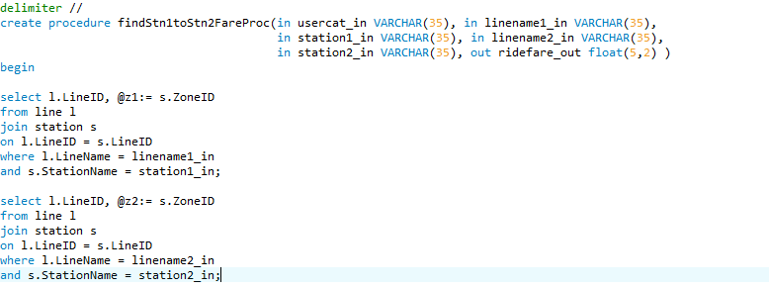
Procedure to capture ride fare for given user group and for going from one station to another – Part 1

Slide 22
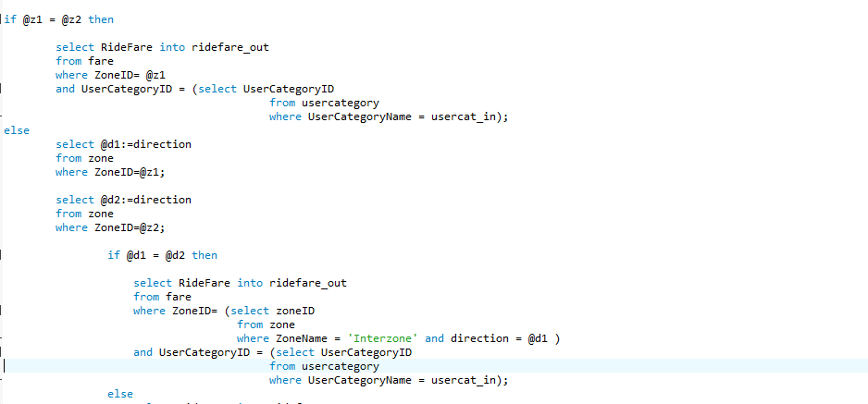
Part 2

Slide 23
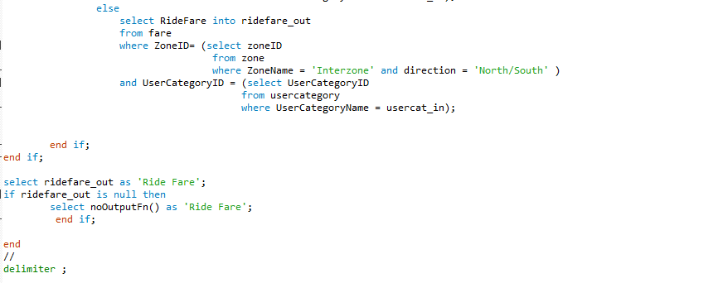
Part 3

Slide 24
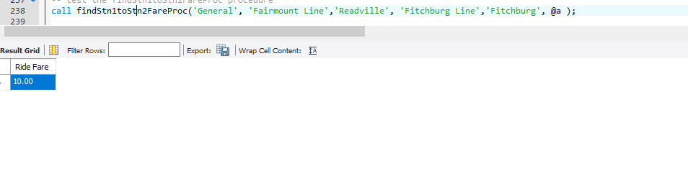
Procedure result

Slide 25
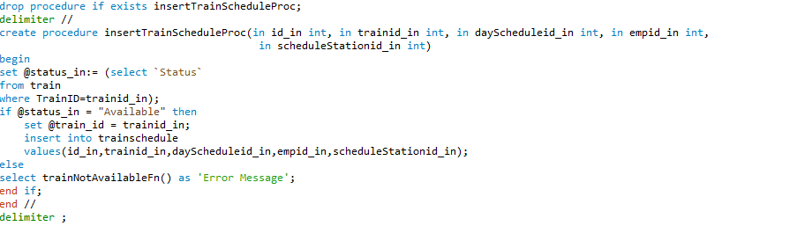
Procedure to capture train id which is scheduled and insert row in train schedule table

Slide 26
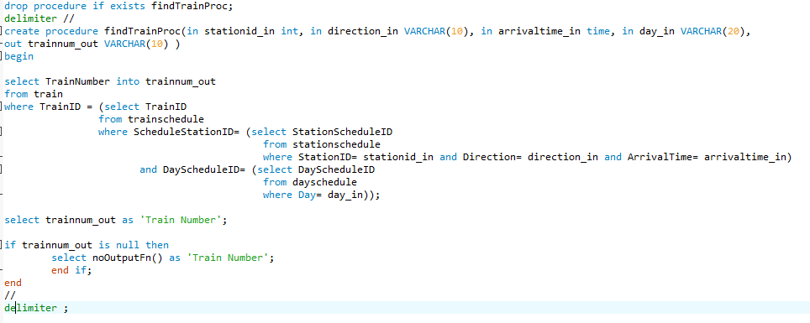
Procedure to capture which train will arrive at given station, time, direction and day

Slide 27
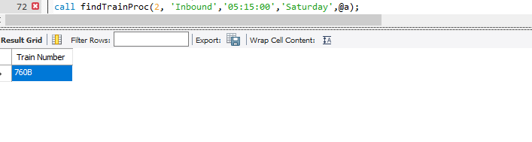
Procedure result

Slide 28
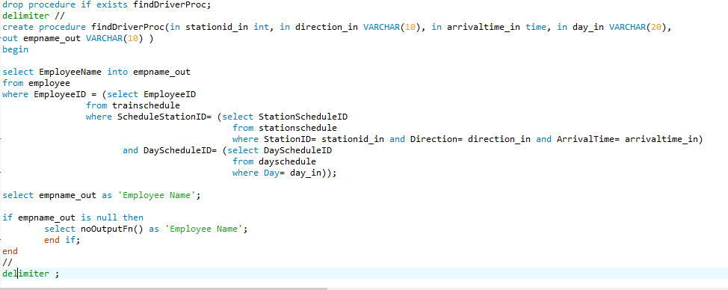
Procedure to capture which train will arrive at given station, time, direction and day

Slide 29
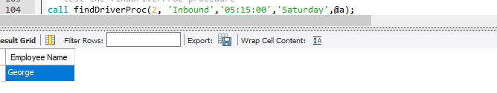
Procedure result

Slide 30
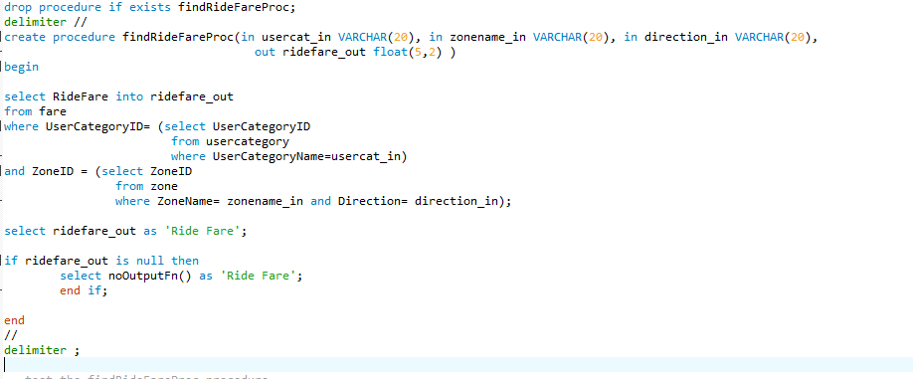
Procedure to capture ride fare for given user group and zone

Slide 31
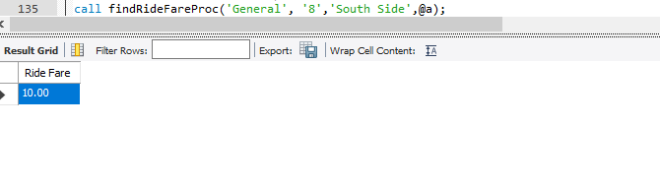
Procedure result

Slide 32
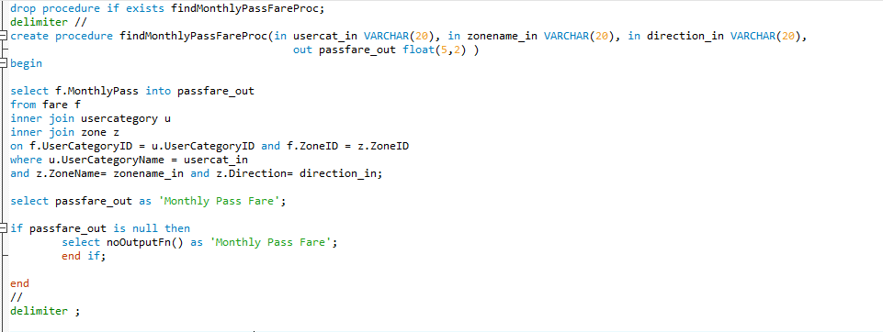
Procedure to capture monthly pass fare for given user group and zone

Slide 33
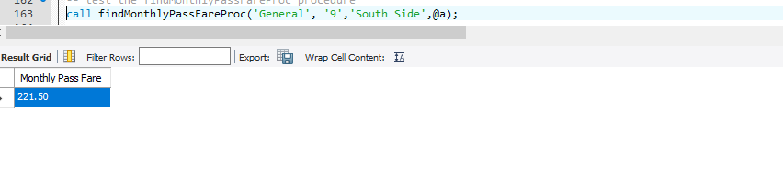
Procedure result

Slide 34
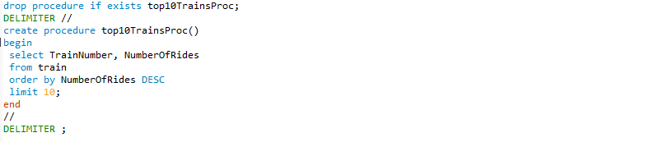
Procedure to find top 10 trains on the basis of usage

Slide 35
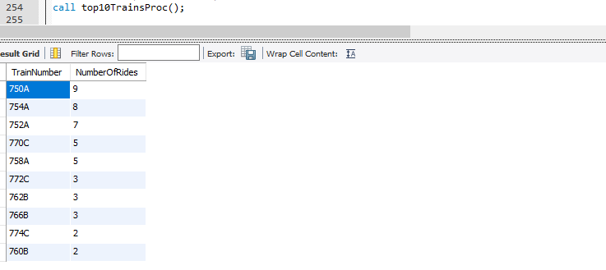
Procedure result

Slide 36
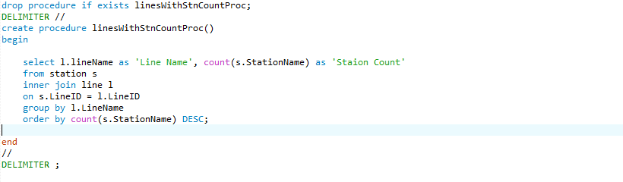
Procedure to find lines with station count and sorted with highest first

Slide 37
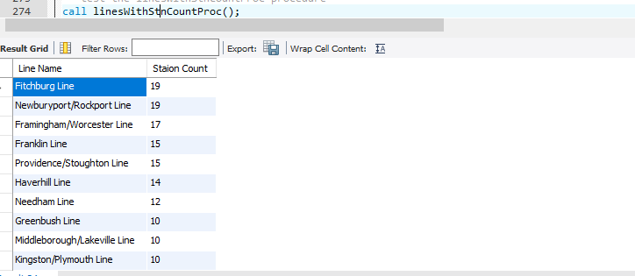
Procedure result

Slide 38
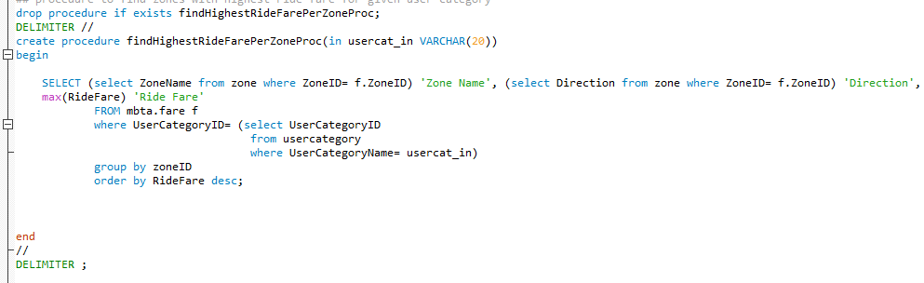
Procedure to find zones with highest ride fare for given user category

Slide 39
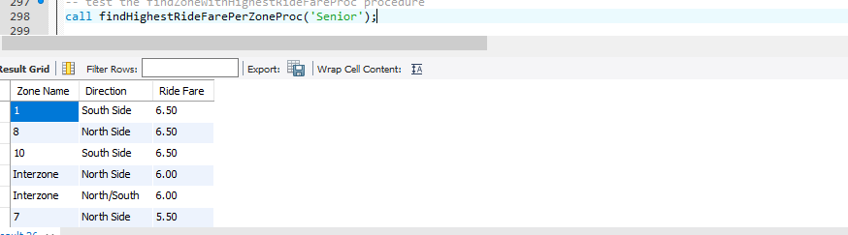
Procedure result

Slide 40
Procedure to create and grant user access
Manager user access: This will give the user access to read, update, insert and delete tables, read stored procedures and functions
Staff user access: This will give the user access to read and update the tables, read stored procedures and functions
Customer user access: This will give the user access to read selected views, functions and stored procedures.

Slide 41
THANK YOU

